Slide 1
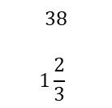
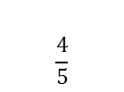
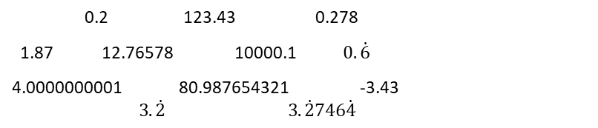
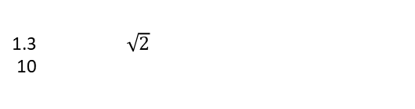
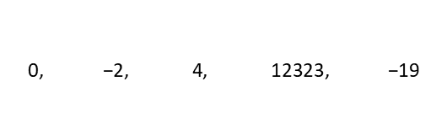
Subtopic N1.7 – Compare decimals using =, ≠, <, >, ≤, ≥
LEARNING OUTCOME: To compare decimals using =, ≠, <, >, ≤, ≥
Objectives:
Keywords:
Decimal
Greater than
Less than
Inequality
To understand the symbols =, ≠, <, >, ≤, ≥
To use these symbols to compare decimals
Introduction – Read and annotate:
Similar to when we compared integers, we use inequality symbols (<, >, =) to show which decimals
are bigger or smaller. This builds on our earlier understanding of place value and comparing whole
numbers, extending those skills to numbers with parts less than one for accurate and meaningful
comparisons.
Definition
Characteristics
A decimal is a number that is not whole, as it lies between whole numbers.
Consists of a whole and a fraction part.
The fractional part is written as digits after a point rather than a fraction.
The whole and fraction parts are separated by a point called the decimal point.
Can be terminating or recurring.
Examples
Decimal
Non - Examples
240
Understanding the ‘Greater than’ and ‘Less than’ symbols to compare decimals
Example 1 - I do…
Example 2 – We do…
Example 3 – You do…
Steps Look at the largest side of the symbol. This should be next to the largest number. | True or false? The inequality shows that 4.3 is greater than 4.2. 4.2 > 4.3 | True or false? The inequality shows that 0.83 is greater than 0.803. 0.803 < 0.83 | True or false? The inequality shows that 0.739 is greater than 0.6. 0.6 < 0.739
 | False | True | True
Steps Look at the smallest side of the symbol. This should be next to the smallest number. | The inequality shows that 0.273 is less than 0.298. True or false? 0.273 < 0.298 | The inequality shows that 40.09 is less than 40.813. True or false? 40.09 > 40.813 | The inequality shows that 5.06 is less than 5.076. True or false? 5.076 < 5.06
 | True | False | False
Example 4 - I do…
Example 5 – We do…
Example 6 – You do…

Slide 2
1. For each of the following questions, decide which statements are true and which statements are false.
Rewrite the false statements to make them true.
Can you write each true statement in a different way such that it remains true? E.g. 8.6 > 8.5 and 8.5 < 8.6 are both true.
Independent Practice
Statement | True or false? | Rewritten to make true (if false) | Alternative way
0.8 > 0.70 | True | - | 0.70 < 0.8
0.80 < 0.7 | False | 0.80 > 0.7 | 0.7 < 0.80
0.8 > 0.809 | False | 0.809 > 0.8 | 0.8 < 0.809
0.8 > 0.509 | True | - | 0.509 < 0.8
0.509 < 0.8 | True | - | 0.8 > 0.509
0.8 < 0.009 | False | 0.8 > 0.009 | 0.009 < 0.8
0.08 < 0.009 | False | 0.08 > 0.009 | 0.009 < 0.08
0.008 < 0.009 | True | - | 0.009 > 0.008
8.09 > 8.01 | True | - | 8.01 < 8.09
8.102 > 8.056 | True | - | 8.056 < 8.102
298.04 > 289.5 | True | - | 289.5 < 298.04
 | Example 7- I do… | Example 8– We do… | Example 9 – You do…
Steps | Place the correct symbol between the numbers (< or >) | Place the correct symbol between the numbers (< or >) | Place the correct symbol between the numbers (< or >)
1) The smallest side of the symbol should be next to the smallest number. 2) The largest side of the symbol should be next to the smallest number. | 6.3 6.7 | 8.21 8.9 | 2.2 2.15
<
<
<

Slide 3
Independent Practice
2. Complete these statements using the symbols > or <
a) | b)
c) | d)
e) | f)
g) | h)
i) | j)
k) | l)
m) | n)
<
<
<
<
<
<
<
<
<
<
<
<
<
<
3. What is the largest integer that makes each statement true?
______ < 3.7 | 3
______ < 73.62 | 73
______ < 0.413 | 0
______ < 0.104 | 0

Slide 4
4. What is the smallest integer that makes each statement true?
4.89 < _____ | 5
105.713 < _____ | 106
0.012 < _____ | 1
0.91403 < _____ | 1
5. Arrange the numbers to fit the chain:
6. Tick the numbers below that could complete the statement 12.5 ≤ _____
12, 5, 4, 1.2, 4.25
12 | > | 5 | > | 4.25 | > | 4 | > | 1.2
12.5 | 12 | 11.5 | 1.25 | 5.21
✔
Understanding the ‘Greater than or equal to’ and ‘Less than or equal to ’ symbols to compare decimals
Example 10 - I do…
Example 11 – We do…
Example 12 – You do…
Steps | List the smallest five integers that satisfy the following inequality | List the smallest five integers that satisfy the following inequality | List the smallest five integers that satisfy the following inequality
Look at the number and the symbol. | ______ ≥ 8.4 9, 10, 11, 12, 13 | ______ ≥ 34.9 35, 36, 37, 38, 39 | ______ ≥ 76.5 77, 78, 79, 80, 81
Use the symbol to decide whether you are listing numbers greater than or equal to, or less than or equal to that number.
 | List the largest five integers that satisfy the following inequality | List the largest five integers that satisfy the following inequality | List the largest five integers that satisfy the following inequality
 | ______ ≤ 8.4 8, 7, 6, 5, 4 | ______ ≤ 34.9 34, 33, 32, 31, 30 | ______ ≤ 76.5 76, 75, 74, 73, 72

Slide 5
Independent Practice
7. List the first five integers that satisfy each of the following inequalities
______ ≥ 1.6 | 2, 3, 4, 5, 6
______ ≤ 5.2 | 5, 4, 3, 2, 1
______ > 0.13 | 1, 2, 3, 4, 5
______ ≥ 0.13 | 1, 2, 3, 4, 5
______ < 6.13 | 6, 5, 4, 3, 2
______ ≤ 6.13 | 6, 5, 4, 3, 2
0.796 ≥ ______ | 0, -1, -2, -3, -4
1.080 ≥ ______ | 1, 0, -1, -2, -3
Three thousand four hundred point five ≤ ______ | 3400, 3401, 3402, 3403, 3404
Twenty seven point one five ≥ ______ | 27, 26, 25, 24, 23
______ > 3.0 | 4, 5, 6, 7, 8
______ ≤ 4.0 | 4, 3, 2, 1, 0
Joe hasn’t thought about numbers greater than 3.9 but less than 4,
Such as 3.91, 3.92 or even 3.9945, for example.

Slide 6
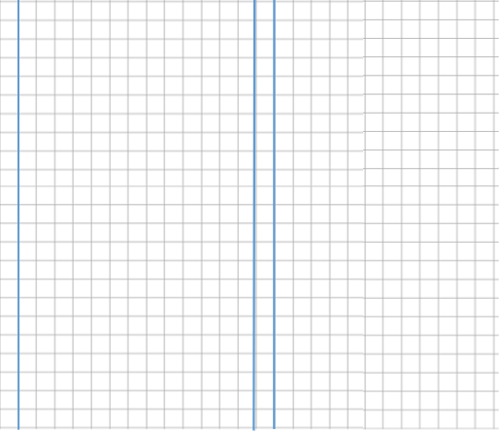
Independent Practice
8. Fill in the missing symbol ( >, <, ≤, ≥), based on the first five integers that have been listed to satisfy the inequality. Some questions may have more than one solution.
Inequality |  |  | First five integers
_____ |  | 7.4 | 8, 9, 10, 11, 12
_____ |  | 114.9 | 114, 113, 112, 111, 110
_____ |  | 70.45 | 70, 69, 68, 67, 66
1080.80 |  | _____ | 1080, 1079, 1078, 1077, 1076
6008.0 |  | _____ | 6008, 6009, 6010, 6011, 6012
_____ |  | Five thousand point six three | 5000, 4999, 4998, 4997, 4996
Five thousand point zero |  | _____ | 5000, 5001, 5002, 5003, 5004
_____ |  | 2 000 000.4 | two million and one, two million and two, two million and three, two million and four, two million and 5
_____ |  | 600 284.00 | Six hundred thousand two hundred and eighty four, six hundred thousand two hundred and eighty three, six hundred thousand two hundred and eighty two, six hundred thousand two hundred and eighty one, six hundred thousand two hundred and eighty
0.00 |  | _____ | Zero, one, two, three, four
0.0901467 |  | _____ | One, two, three, four, five
> or ≥
< or ≤
< or ≤
> or ≥
≤
< or ≤
≤
> or ≥
≤
≤
< or ≤

Slide 7


Understanding the ‘not equal to’ symbol to compare decimals
Example 16 - I do…
Example 17 – We do…
Example 18 – You do…
Steps | Complete the following using = or ≠ | Complete the following using = or ≠ | Complete the following using = or ≠
Decide whether the two values are equal or not.
If they are equal, use the ‘=‘ sign. If they aren’t, use the ≠ sign
Two hundred and six tenths
Three thousand point four seven
Sixty-eight thousand point nine
=
≠
3000.47
=
68 000.9
200.06
Independent Practice
9. Complete these statements using the symbols = or ≠
a) | b)
Five hundred and forty point zero one. | Eighty-three and seven tenths
c) | d)
Nine thousand, five hundred point three nine seven | Twelve thousand, two hundred, and fourteen hundredths
e) | f)
g) | h)
=
≠
83.07
≠
12 200.14
=
=
=
0.50
0.5
0.5
0.500
≠
950.067
≠
950.670
950.607
950.67
Skills Check
Which is the correct symbol to go on the line below? 5.65 ____ 5.7 A. = B. < C. > D. None of these
List the smallest five integers that satisfy the following: _____ ≥ 18.015 A. 18, 17, 16, 15, 14 B. 18, 19, 20, 21, 22 C. 17, 16, 15, 14, 13 D. 19, 20, 21, 22, 23
Which one of the following statements is correct? 170.50 ≠ one hundred and seventy and five tenths Eleven thousand and one tenth ≠ 11 000.1 C. Eleven thousand and one tenth ≠ 11 000.01 D. Two hundred and eighty point zero six = 280.006

